Slide 1
Research Writing on AI for Financial Risk Topic
Writing paper exactly as per requirements and methodology

Slide 2
Content and steps
Gather references using zotero
Organize references – course mix of trade and journal, old vs recent, classical papers from course. Using EBSCO and settings. Google scholar remaining relevant.
Write paper using Deepseek for Latex texstudio
Map it to the requirements again
Ask other AI to check again
Trim down and manually fix changes

Slide 3
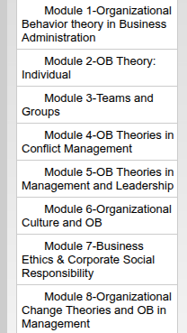
List of Modules for using classical references
8 modules (10) = 80 - select 15
Each module has diff papers
We will select the doi or good journal paper
We will also select any trade paper (ebsco) 5
Then after opening in browser we will get it in zotero
External 5

Slide 4
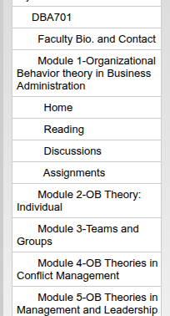
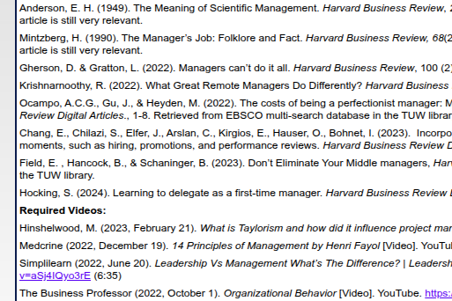
How to gather references

Slide 5
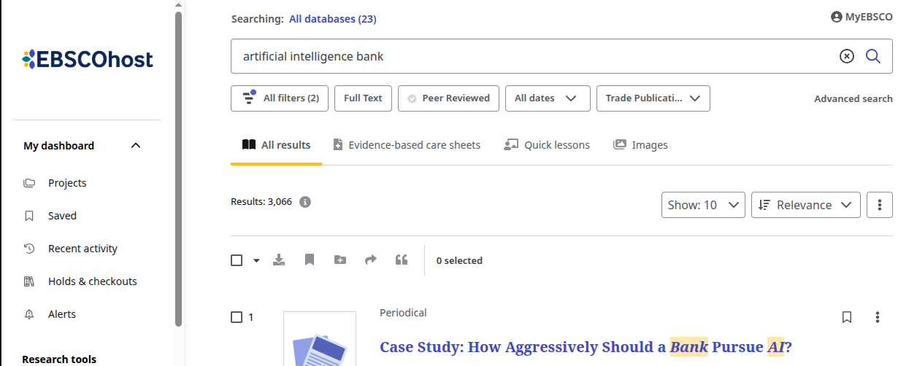
EBSCO Search for Trade Papers

Slide 6
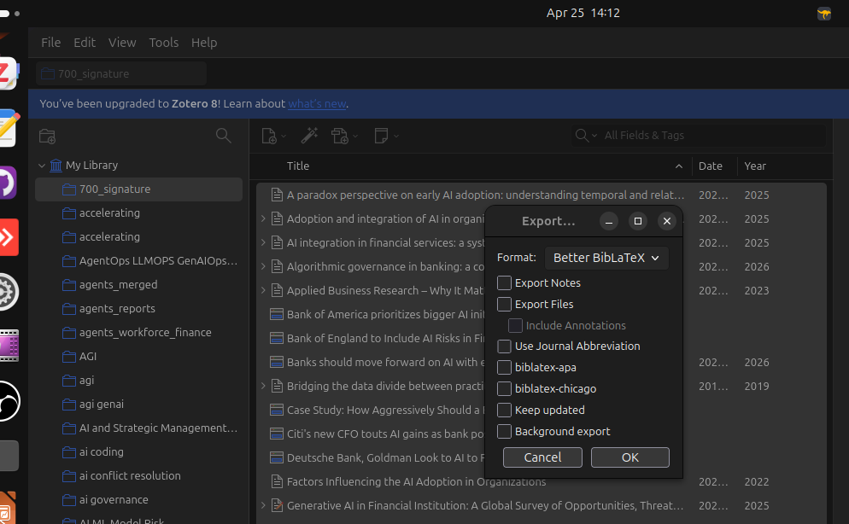
Export
BibLatex

Slide 7
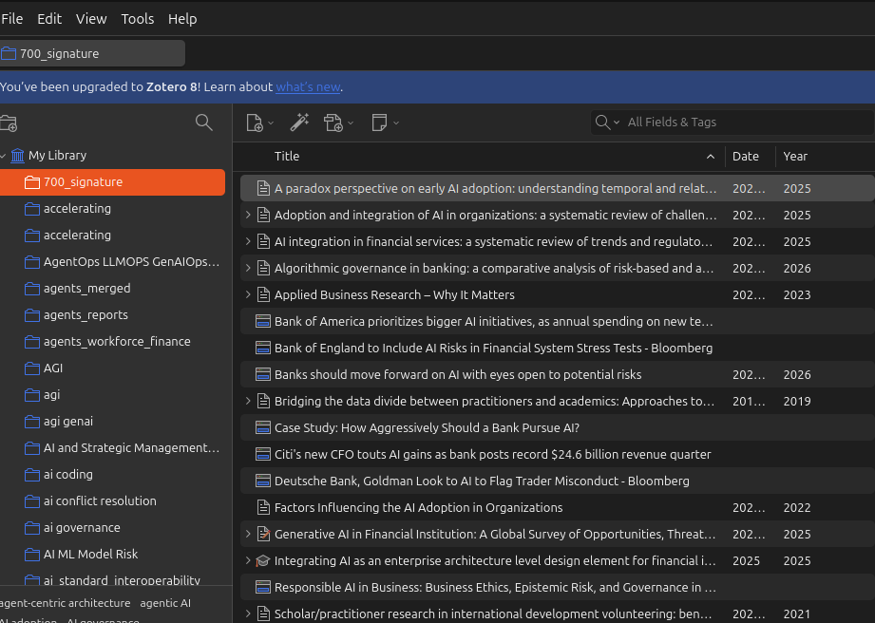
Zotero
Fix author
Year
Check mix

Slide 8
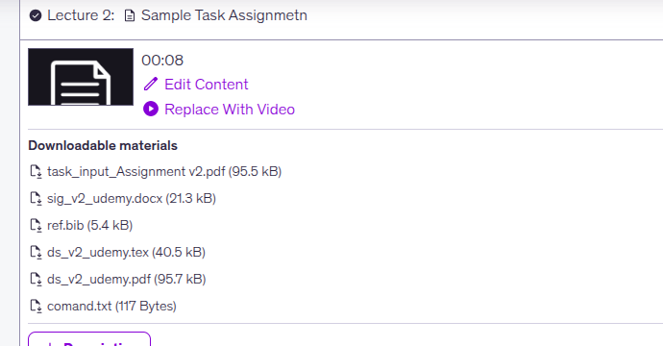
Sample Task Deliverable

Slide 9
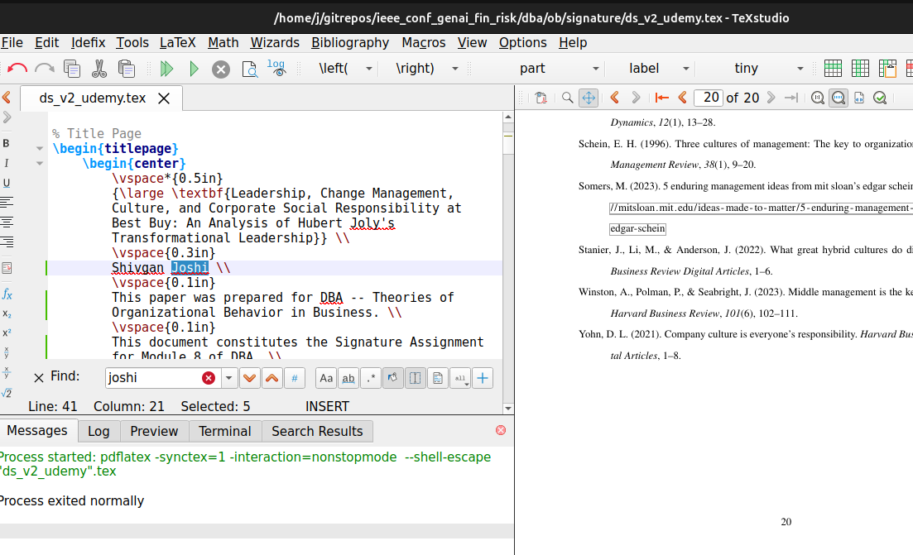

Slide 10
Variations of Assignment
Biggest: Full project, where you use EBSCO and 8 Modules
Small project only AI Fix – humanzier - zerogpt
Mid project you get bib file and you have to fix bib file, and created new latex from the provided latex already generatd and new doc and fix ai. Here you don’t need to find the best references.

